Slide 1
SPAM or HAM
Hal Baird
Dana Dippery
Anthony Redamonti
Joshua Wolfe

Slide 2
Introduction
Artificial Intelligence is a subset of Computer Science in which computers solve problems normally handled by biological systems.
Machine Learning and Natural Language Processing are overlapping subsets of Artificial Intelligence.
Performing Natural Language Processing well is hard to do.

Slide 3
Agenda
First, we will discuss why and how we have applied Machine Learning techniques to accomplish Natural Language Processing to identify spam SMS Messages
Second, we will discuss the degree to which we were successful, I.e., what worked, what did not work and why
Lastly, we will provide our recommendations for future efforts in this regard

Slide 4
Motivation
Hackers use SMS messaging to send phishing scams to unsuspecting users.
SMS SPAM messages act as active attack vectors, breaching the user's security and stealing their private data.
Phishing via SMS has increased ten-fold between April 2021 and April 2022.

Slide 5
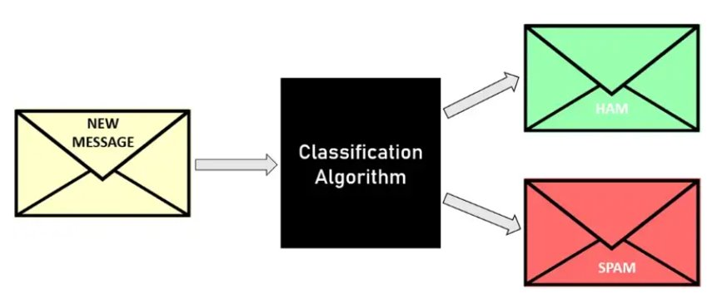
HAM: messages that are desired
SPAM: messages are not desired
Notes:
As we've discussed earlier, SPAM is a growing attack vector that can lead to devastating impacts. To proactively defend against these attacks, a machine learning model can be used to actively classify SMS messages as SPAM or not SPAM. To create this classification model, several steps must first be taken.

Slide 6
Data Sources
5158 labeled spam/ham messages from University of California Irvine Machine Learning Repository
762 labeled spam/ham messages from public Kaggle data sets
See index for sources
Notes:
Retrieving somewhat healthy data with a medium level of confidence was the first issue we faced. Initially data from UCI's ML repository look good, but after further inspection there was more to be desired. After scouring the web, the team was able to com up with 5920 data points across UCI's ML repo and Kaggle's online dataset repository.

Slide 7
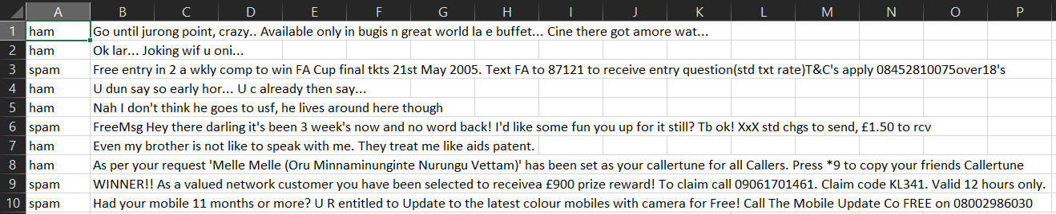
Data Format
10 CSV files from 2 Sources: The University of California Irvine Machine Learning Repository and Kaggle.com
5,920 unique entries total
Notes:
These datasets spanned 10 CSV files. This was initial great, due to no missing values, consistent data types, etc. But after digging further into the data a small percentage of duplicates (<10%). After this initial cleaning of removing duplicates we preprocessed the data in 2 stages and then performed exploratory data analysis to better understand the total dataset and perform better tuning of our models.

Slide 8
Natural Language Processing (NLP)
Enables machines to read and understand human language
Accomplished using various machine learning techniques
Using NLP, we can accomplish:
Question answering, sentiment analysis, natural language generation, speech recognition, automatic text summarization, etc.
Large data analysis, automate time consuming processes, and create opportunities for innovation in various markets
Example: Amazon's Alexa, Apple's Siri, OpenAI's ChatGPT

Slide 9
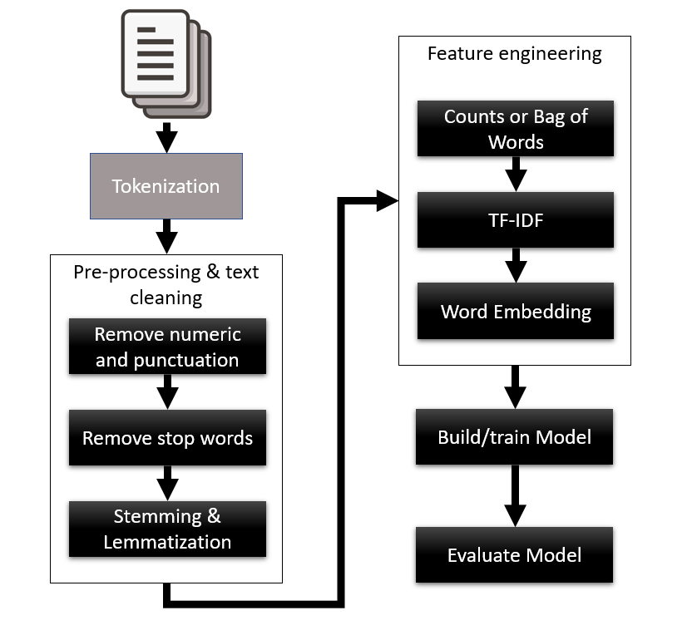
NLP Text Classification Workflow
Preprocessing
General Preprocessing
URLs, NANP
NLP Preprocessing
Tokenization
Removing stop words
Word Stemming
Word Lemmatization
Feature Engineering
Counts & Frequencies
Bag of Words
TF-IDF
Word Embedding
Build/Train/Evaluate Models

Slide 10
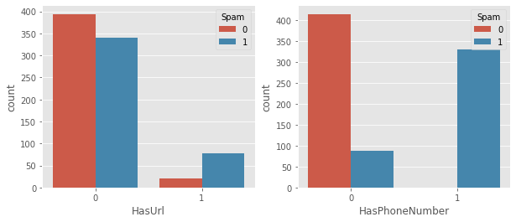
Preprocessing: URLs & NANP
Mapping RegEx across the dataset, SPAM doesn't include many URLs, but telephone numbers and shortcodes are key identifiers of spam.

Slide 11
Preprocessing: Lemmatization & Stemming
Word Stemming: the process of reducing words in a document down to their stems (base version of the word).
Example:
am, are, is => be car, cars, car's, cars' => car
Example: "I went to many stores and bought milky way candy bars."
Stemmed version: "I go to many store and buy milk way candy bar."
Word Lemmatization: the process of determining the lemma (root) of a word based on its intended meaning.
Example: "Saw"
If Verb => Root = "See"
If Noun => Root = "Saw"

Slide 12
Preprocessing: Vectorization
Vectorization: the process of using tokenized words to create a unique, alphabetized vocabulary and converting it to a binary vector.
Example:
"Data mining is fun." "Data mining is used to solve important problems."
Vocabulary: ['Data', 'fun', 'important', 'is', 'mining', 'problems', 'solve', 'to', 'used']
Vectors:
"Data mining is fun." => [1, 1, 0, 1, 1, 0, 0, 0, 0]
"Data mining is used to solve important problems" => [1, 0, 1, 1, 1, 1, 1, 1, 1]

Slide 13
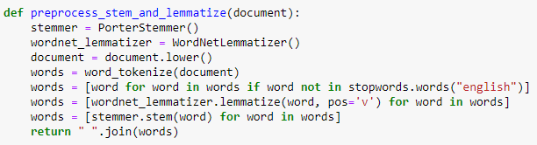
Convert to lowercase
Tokenize (divide each word)
Remove unnecessary "stop words" ('the', 'a', 'of', 'for', etc.)
Lemmatize remaining words (as verbs) using Porter Stemmer algorithm
Stem remaining words

Slide 14
Preprocessing: TF-IDF
TF-IDF: the process of identifying words uniquely associated with document (relative to a corpus of documents)
TF-IDF: term frequency inverse document frequency
The process looks for words that have frequency in a document but low frequency (relatively) in a corpus of documents
Example:
A medical document about Hypertension will have a high frequency (TF) for the word "cardiac" compared to most other news documents
The same document will have a high frequency for the word "and" but so will other documents, so this word's score is reduced (IDF)
The word “cardiac” is associated with a document about hypertension
Notes:
Scoring SMS messages by the frequency of words ignores uncommon words that may contain more relevant meaning (naive approach). A better method of scoring is called Term Frequency over Inverse Document Frequency or *TF-IDF*. This score takes the frequency of a word in a message and divides it by the inverse frequency of that word as it appears in all the messages.

Slide 15
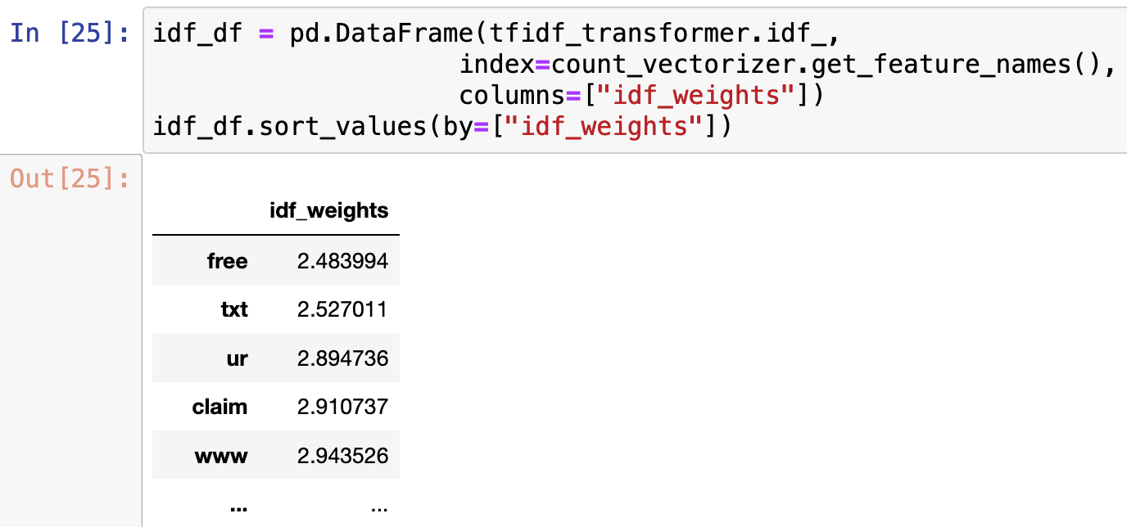
Preprocessing: TF-IDF
Term Frequency over Inverse Document Frequency or TF-IDF
Most frequent SPAM words:
free
txt
ur
claim
www

Slide 16
Model Training
Data set was split
70% used for training
30% used for testing
Primary Scoring:
Precision: True Positives / (True Positives + False Positives)
Models were first selected by highest spam precision score
Models that minimized false positives (hams classified as spam) desired
Secondary Scoring:
Models were then selected based on F1 score
Models that found the most spam, of all known spam, were the second priority

Slide 17
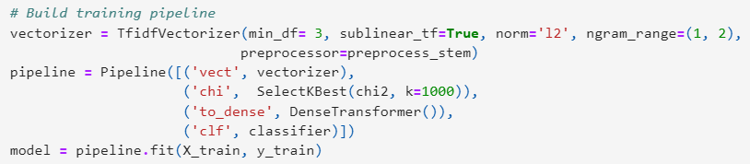
Building Training Pipeline
Sklearn description of a pipeline: "The purpose of a pipeline is to assemble several steps that can be cross-validated together while setting different parameters."
SelectKBest: selects the K features with the highest chi^2 score

Slide 18
Testing Results

Slide 19
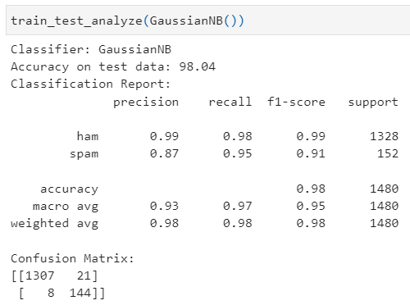
Results: Gaussian Naïve Bayes Classifier
Probabilistic classification algorithm
Assumes that all features are truly independent and of equal weight.
Proficient at handling continuous features.

Slide 20
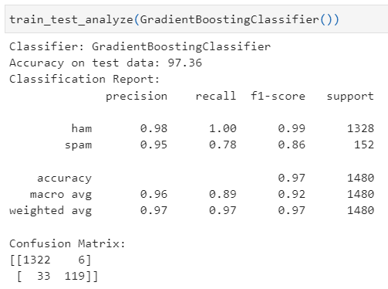
Results: Gradient Boosting Machine (GBM) Classifier
Ensemble learning method
Sequentially tests each model against the training data, improving its performance with each iteration.
Adjusts the weight of entries that are incorrectly predicted by base classifiers.
Because it uses sequential operations, it typically takes a longer amount of time to perform its operation, but the performance is usually high.

Slide 21
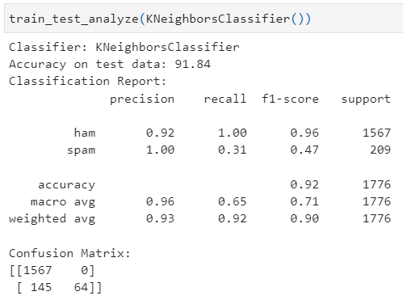
Results: K-Nearest Neighbors (KNN) Classifier
Distance-based, supervised learning algorithm
Generally, yields high performance in real-world applications as it can tolerate a large, noisy dataset.

Slide 22
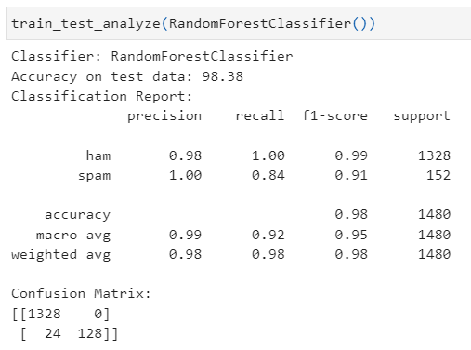
Results: Random Forest Classifier
Ensemble learning method
Randomly selects subsets of the training set to build a set of decision trees
Uses the votes of the decision trees to decide the final prediction.
Every individual decision tree votes, and the majority wins.

Slide 23
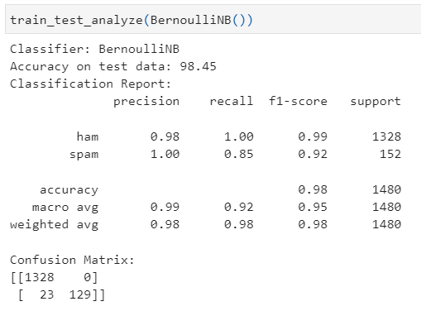
Results: Bernoulli Naïve Bayes Classifier
Probabilistic classification algorithm
Assumes that all features are truly independent and of equal weight.
Proficient at handling binary features.

Slide 24
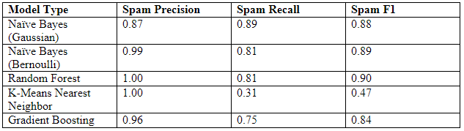

Results Summary
Based on these results and the scoring criteria, the Random Forest based model clearly demonstrates the best performance for identifying spam messages with respect to precision and recall.

Slide 25
Improvements and Next Steps
While the RFC model shows significant promise towards classifying spam SMS messages, there are several limitations that our team noted

Slide 26
Improvements and Next Steps
The dataset is small: 5,920 entries
The dataset is unbalanced: # HAM entries > # SPAM entries
The features are limited (only 2): target HAM/SPAM label and textual message label
Other message features may be insightful, such as timestamps, origination, URL meta data, is this a known contact, etc.

Slide 27
Improvements and Next Steps
The model output is limited to binary predictions
A future enhancement would be to predict SPAM based on a probabilistic scale rather than 0 or 1. Such a prediction could be fed into other machine learning algorithms that consider other factors.

Slide 28
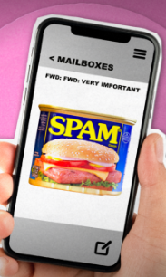
Thank You!
Team Spam-a-Lot

Slide 29
Data Sources
UCI Data:
https://archive.ics.uci.edu/ml/machine-learning-databases/00228/
Kaggle Sources:
https://www.kaggle.com/datasets/arunasivapragasam/spam-or-ham
https://www.kaggle.com/datasets/hdza1991/sms-spam
https://www.kaggle.com/datasets/shravan3273/sms-spam
https://www.kaggle.com/datasets/shrutipandit707/smsspamcollection

